Slide 1
EMOTION RECOGNITION THROUGH FACIAL EXPRESSION USING ARTIFICIAL NEURAL NETWORK
RUDHRA Y 2021506076 Madras Institute of Technology, AU

Slide 2
PROJECT TITLE
This project is to design and implement a robust system capable of accurately recognizing and interpreting emotions from facial expressions in real-time. By leveraging artificial neural networks, we aim to develop a model that can effectively analyze facial cues and classify emotions with high accuracy. The ultimate goal is to enhance communication by providing real-time feedback on emotional states, enabling individuals to better understand and respond to the emotions of others.

Slide 3
PROBLEM STATEMENT
For elderly women with speech impairments, conveying emotions and thoughts can present considerable challenges. This pioneering project introduces a unique methodology by analyzing physiological cues, such as eye movement and heart rate, to interpret emotions in individuals with speech limitations.
By discerning non-verbal signals like gaze patterns and physiological responses, the system aims to assist these individuals in expressing their emotions more effectively, thereby enhancing their emotional well-being and communication skills. This initiative not only holds promise for improving the lives of elderly women facing speech limitations but also for advancing our understanding of emotional expression. It endeavors to provide a voice to those who have long struggled to articulate their feelings effectively. In essence, this endeavor addresses a significant gap in meeting the communication needs of a marginalized demographic.
Through the integration of technological advancements and psychological insights, it offers a fresh perspective on a persistent challenge. By analyzing physiological data and employing innovative techniques, the system seeks to provide tailored support to address the unique communication obstacles encountered by speech-impaired individuals.

Slide 4
PROJECT OVERVIEW
Emotions of humans captured at real time
Images given as input to the trained artificial neural network model
Model is already trained with input images and tested
Model predicts the emotions of input image
Project Model gives accuracy of 95 percent
Model is deployed in cloud and made available for end users
Helping in providing appropriate psychological aids

Slide 5
END USERS
The end users of this groundbreaking prototype are humans especially geriatric women with speech impairments, who often face challenges in expressing themselves verbally. By harnessing innovative technology such as eye-tracking and heart rate monitoring, the system enables these users to communicate effectively by interpreting non-verbal cues.
This empowers them to convey their emotions and thoughts accurately, thereby enhancing their emotional well-being and communication skills. Ultimately, the prototype aims to improve the quality of life for elderly women with speech impairments by providing them with a more inclusive and accessible means of communication.

Slide 6
SOLUTION PROVIDED
Emotion recognition through facial expression offers a compelling solution to enhance communication on multiple fronts. By accurately interpreting facial cues, this technology can bridge gaps in understanding, particularly in situations where verbal communication may be limited or ambiguous.
In interpersonal interactions, it can facilitate empathy and rapport-building by enabling individuals to perceive and respond to subtle emotional signals. In addition, in contexts such as customer service or counseling, emotion recognition can aid in tailoring responses to better meet the emotional needs of clients or users.
Moreover, in educational settings, it can support personalized learning experiences by gauging student engagement and adjusting instructional strategies accordingly. Overall, leveraging facial expression analysis for emotion recognition holds significant potential to foster deeper connections, mitigate misunderstandings, and optimize communication dynamics across various domains.

Slide 7
METHODOLOGY USED
Data Collection and Preprocessing: Gather a diverse dataset of facial expressions representing various emotions, including happiness, sadness, anger, surprise, fear, and disgust. Preprocess the data to enhance quality and consistency, including face detection, alignment, and normalization.
Feature Extraction: Extract relevant features from facial images, such as facial landmarks, texture descriptors, and geometric properties, to capture key characteristics indicative of different emotions.
Artificial Neural Network Design: Design and train an artificial neural network architecture optimized for emotion recognition tasks. Experiment with different network architectures, activation functions, and training algorithms to achieve optimal performance.
Model Training and Evaluation: Train the neural network using the preprocessed dataset and evaluate its performance using metrics such as accuracy, precision, recall, and F1-score. Employ cross-validation techniques to assess the model's generalization ability.
Real-time Implementation: Implement the trained model into a real-time system capable of capturing live video streams, processing facial expressions, and providing instantaneous feedback on detected emotions.
Testing and Validation: Conduct extensive testing and validation of the system in various communication scenarios, including interpersonal interactions, customer service simulations, and educational environments. Gather feedback from users to assess the system's effectiveness and usability.

Slide 8
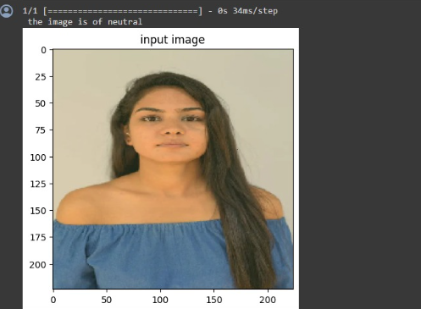
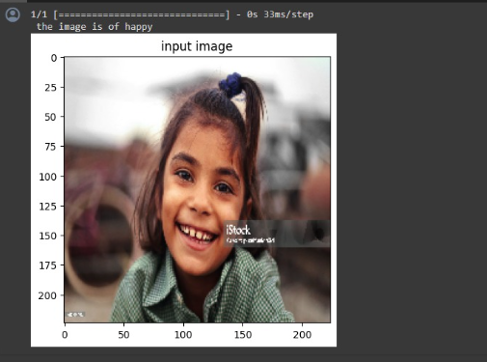
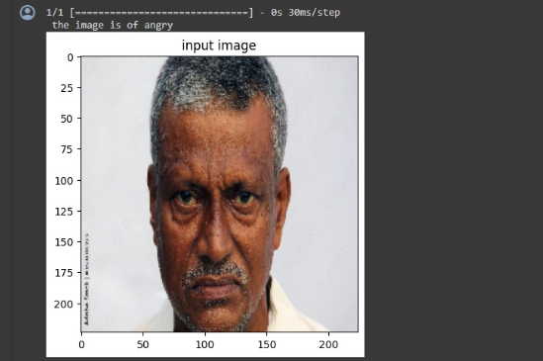
RESULTS
https://drive.google.com/file/d/1GtRcIXaJB2eDDOv-_-Ae0Eorn1vPCUpQ/view?usp=drivesdk

